Slide 1
OAuth og OpenID Connect

Slide 2
Agenda
OAuth 2 Termer
Authorization Code Flow
OpenID Connect
PKCE Flow

Slide 3
OAuth 2.0 Terminologi
Resource Owner
Resource Server
Client
Public - PKCE
Confidential - Client Secret
Authorization Server
Scopes
Grants
Authorization Code
PKCE
Refresh
Tokens
Access
Refresh

Slide 4
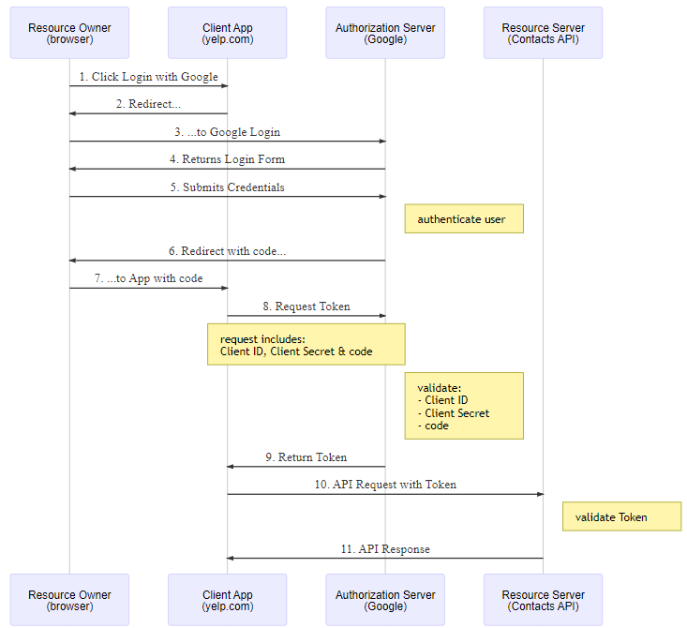
Eksempel Authorization Code Flow
Scope Dialogue

Slide 5
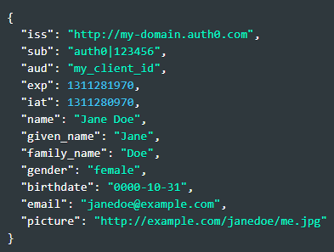
OpenID Connect
Bygger ovenpå OAuth
Termer
End User
Relying Party
OpenID Provider
Standardized scopes
openid
profile
email
ID Token (JWT)
Claims

Slide 6
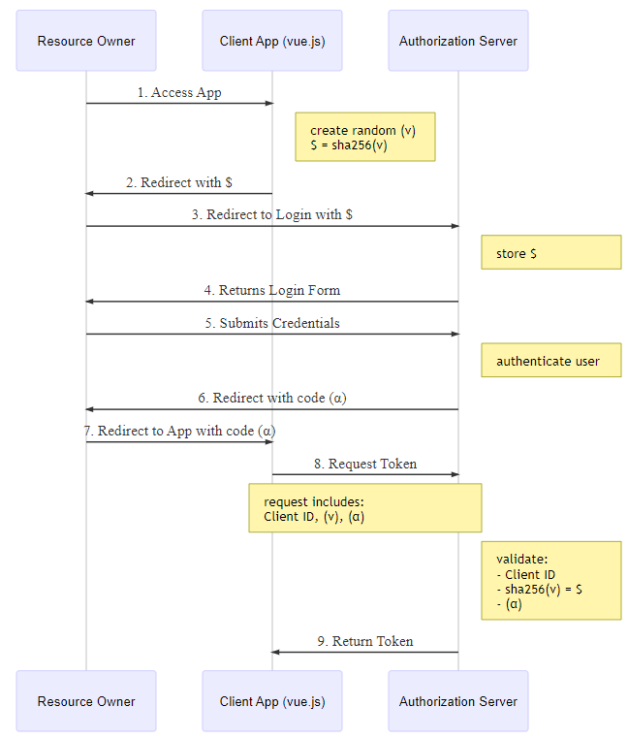
PKCE flow

